Slide 1


CASE IT UP
(PURCHASING PHONE CASES APP)
By: Alapide, Rhea Mae D.
Cacao, Bience Nico H.
Garcia, Carlo
Reyes, Allen Francis Z.
Villanueva, Meryll Denise C.
Final Project in IT-332
Integration Programming and technologies
Ms. Kimberly Marasigan

Slide 2

PRODUCT DESCRIPTION
Phone cases around the world have played an important part in protecting smartphones from unnecessary damages throughout its usage. It keeps phones look new as long as possible, and it increases the lifespan of the smartphone. However, phone cases tend to have a uniform design that bores the users in many places, and in order to address that issue, the team aims to design and develop a mobile application that would allow users to design the phone cases according to their preferences.

Slide 3
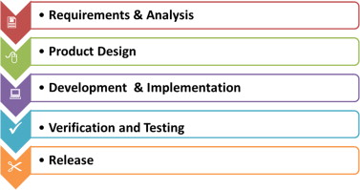
TRADITIONAL WATERFALL MODEL

Slide 4
WATERFALL MODEL
Waterfall development approaches utilize a progressive design process. The objectives and architecture of a program are determined before any coding is begun, which is an advantage of this model. This implies that tools, functionality, and methodologies are thoroughly planned and thought through prior to the beginning of the implementation phase.

Slide 5
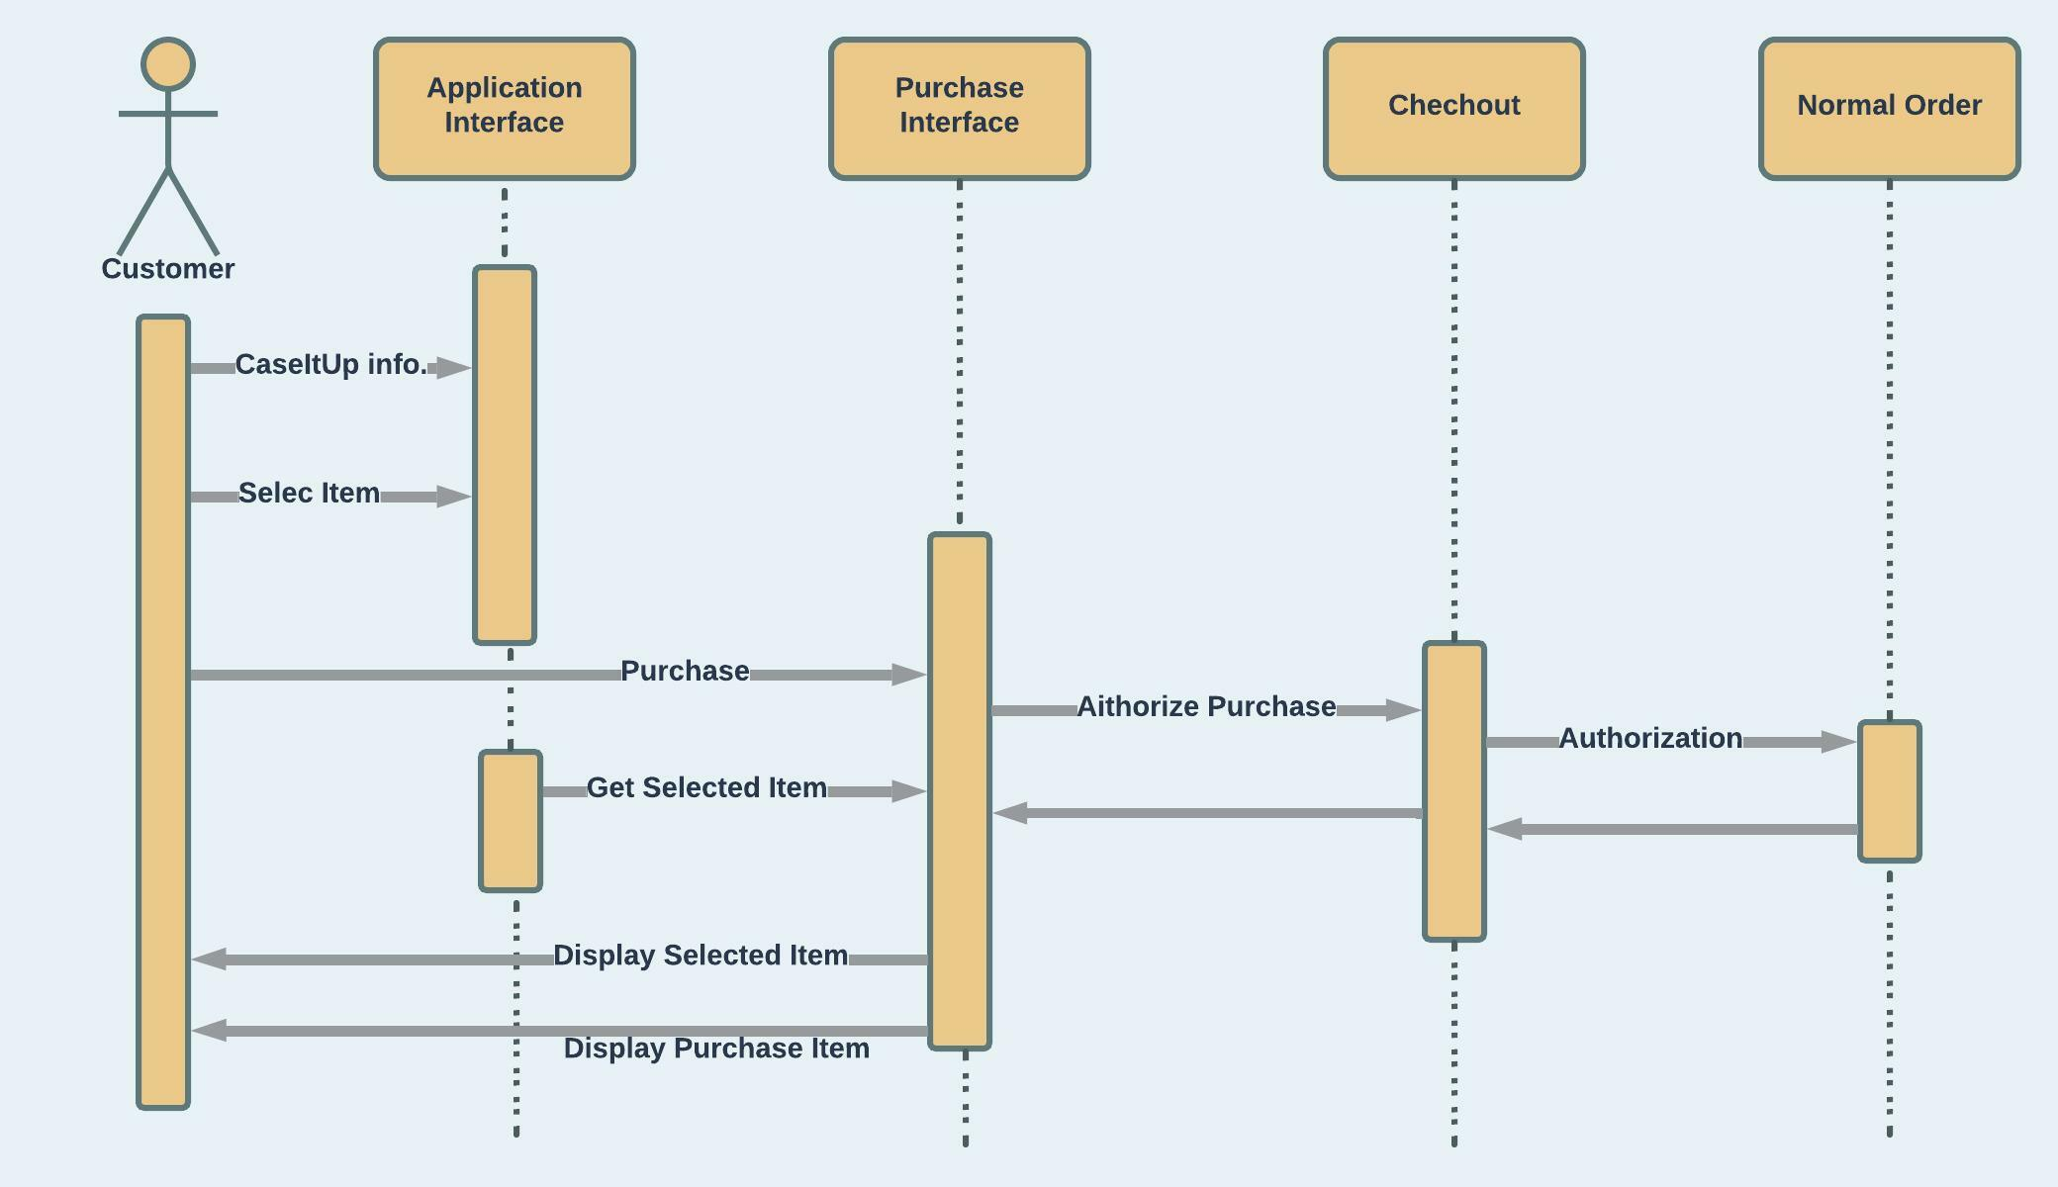
SYSTEM ARCHITECTURE,
Sequence Diagram

Slide 6
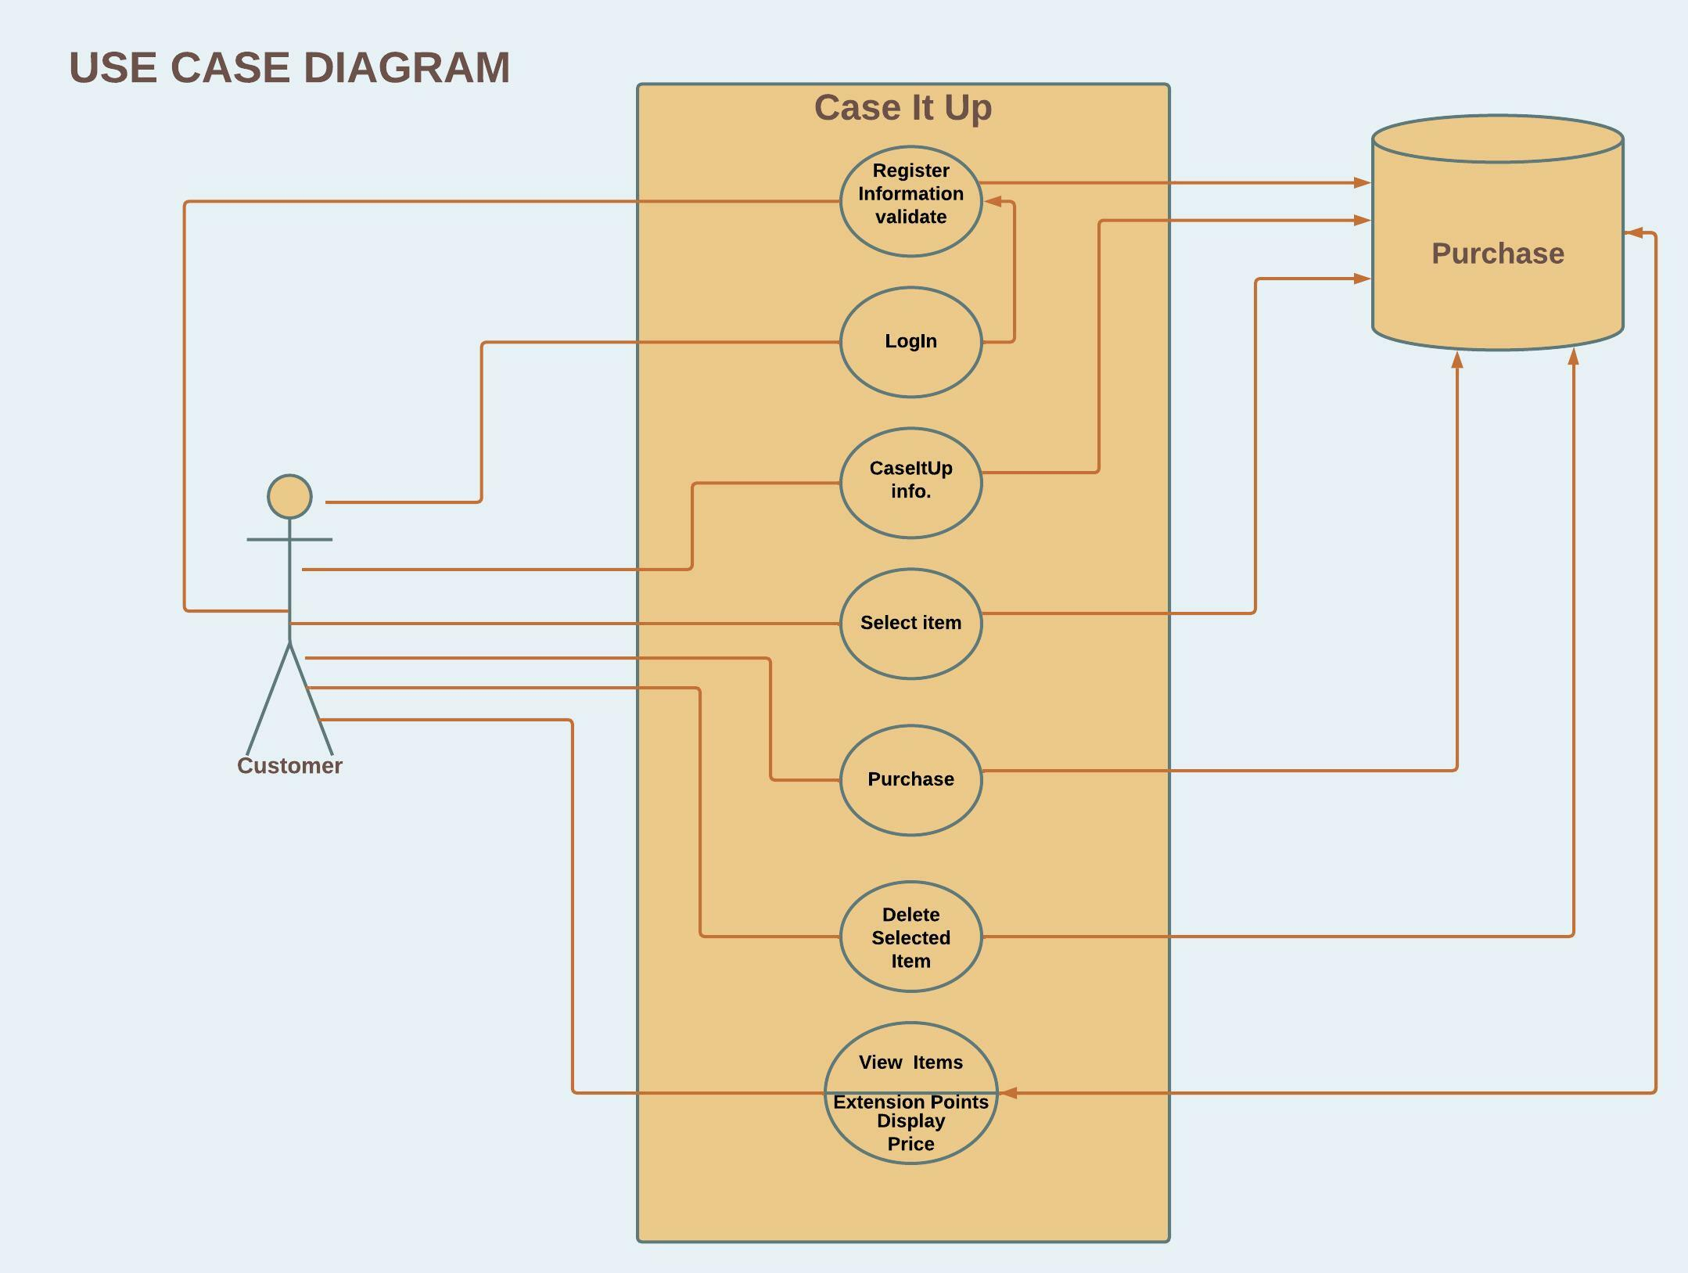
SYSTEM ARCHITECTURE

Slide 7

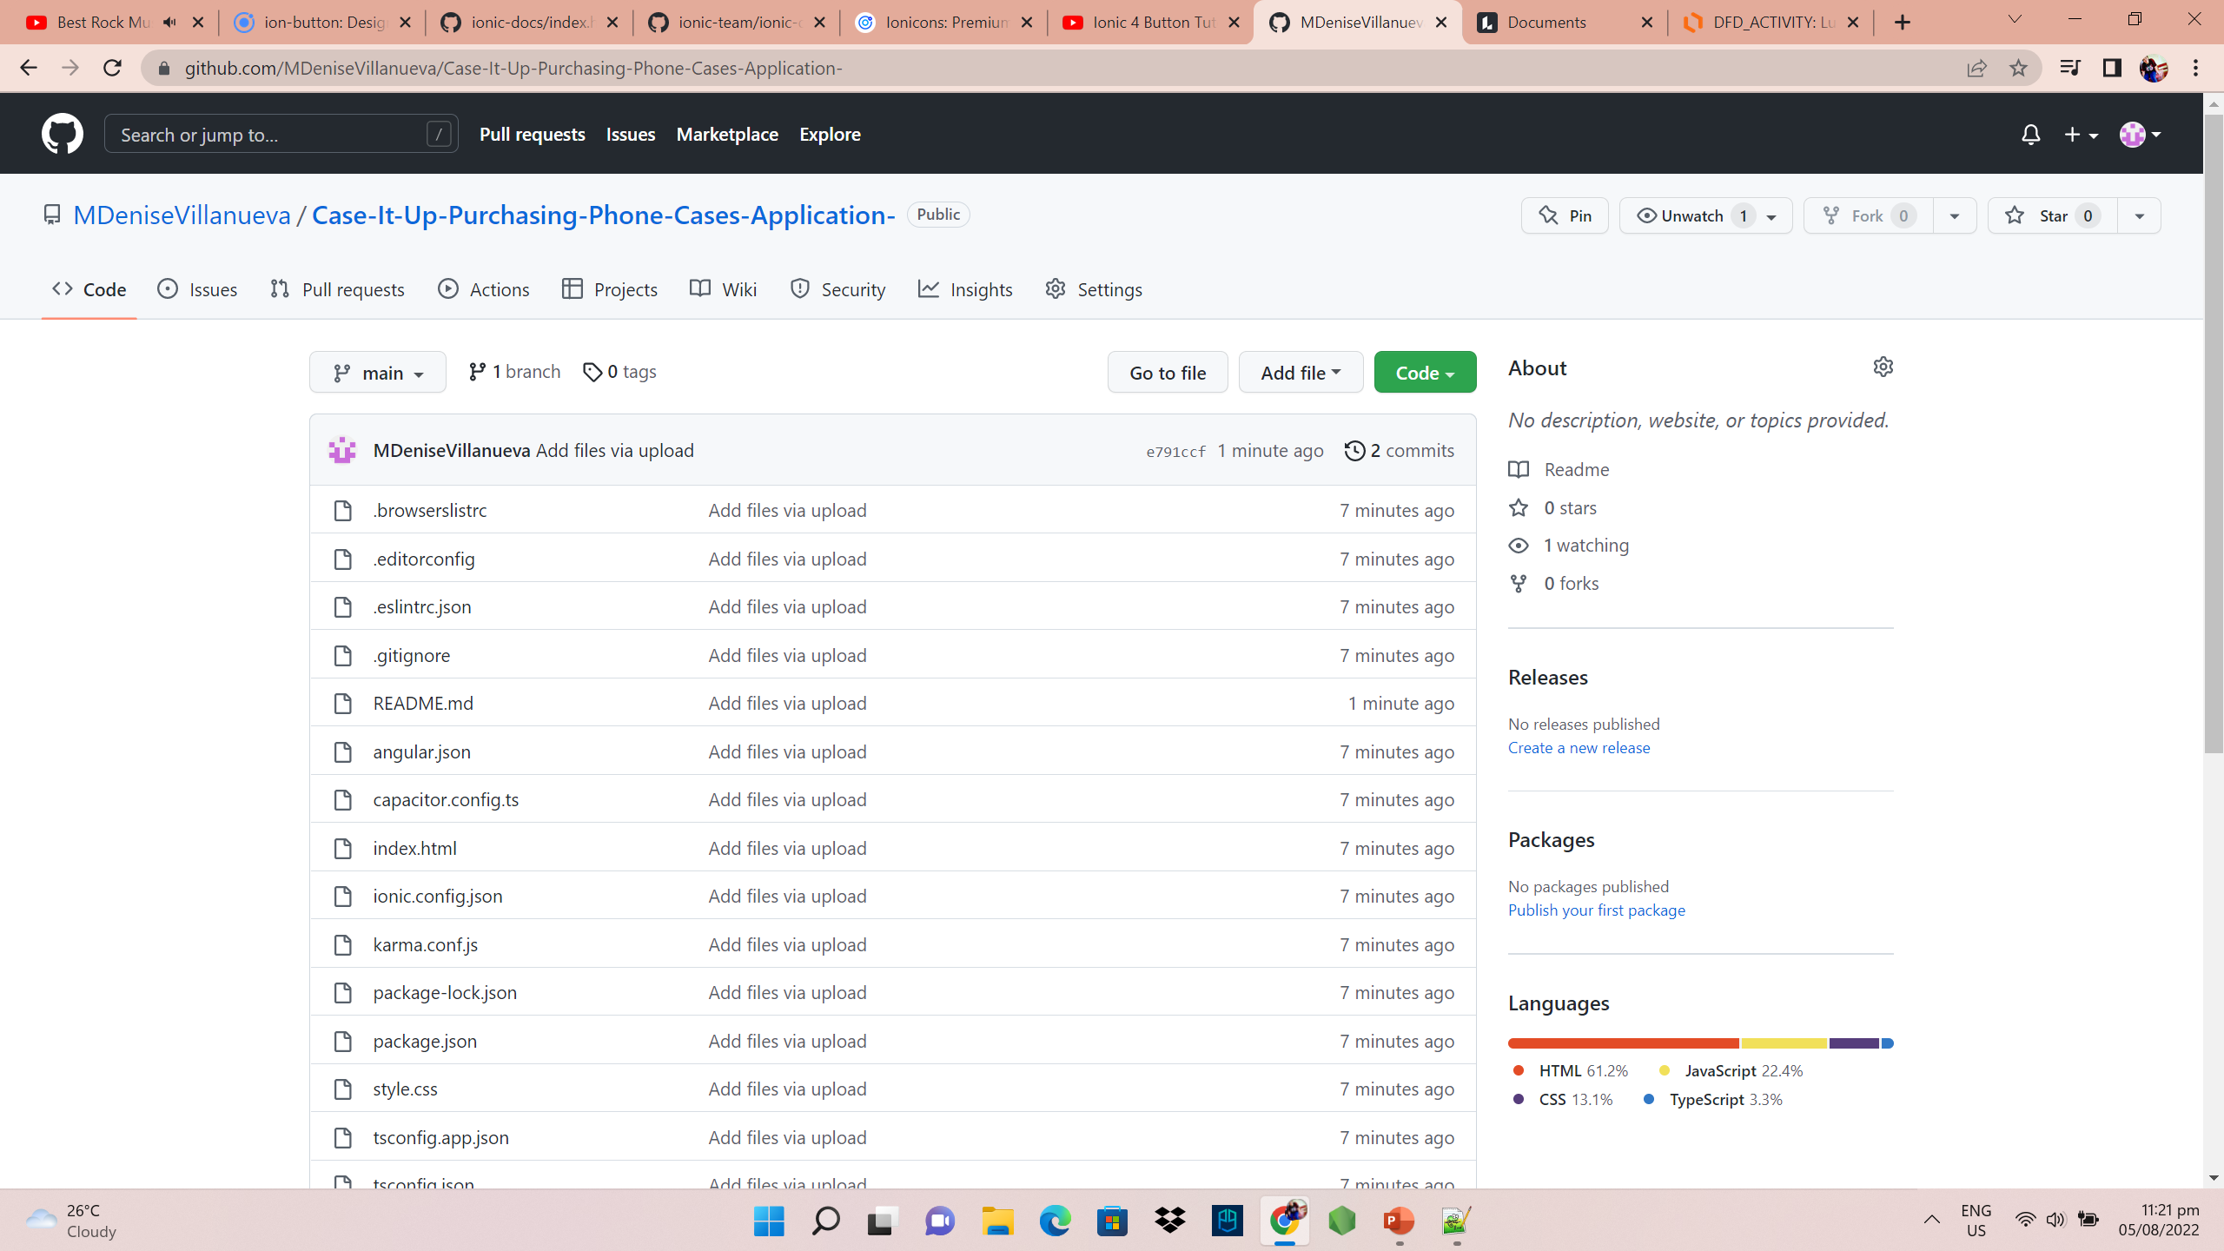
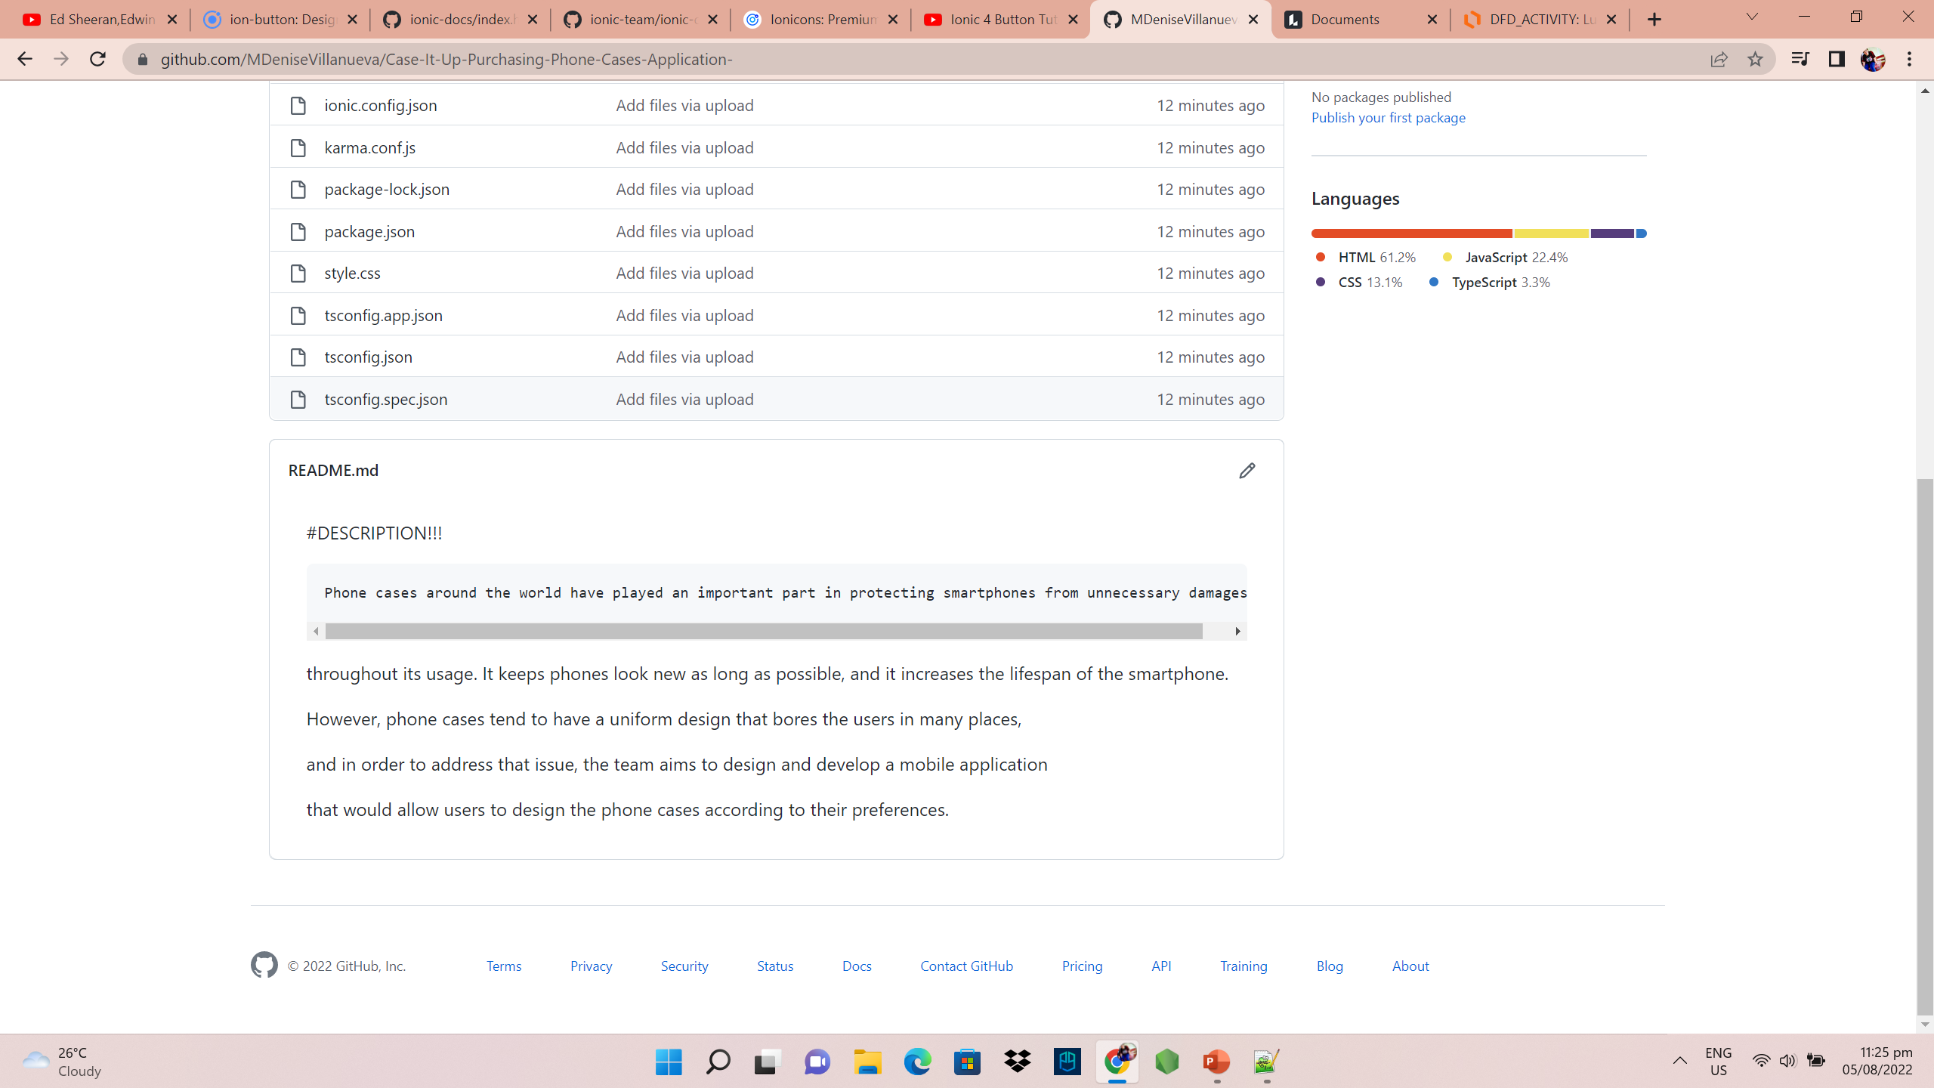
https://github.com/MDeniseVillanueva/Case-It-Up-Purchasing-Phone-Cases-Application-.git
GITLAB REPOSITORY
LINK

Slide 8

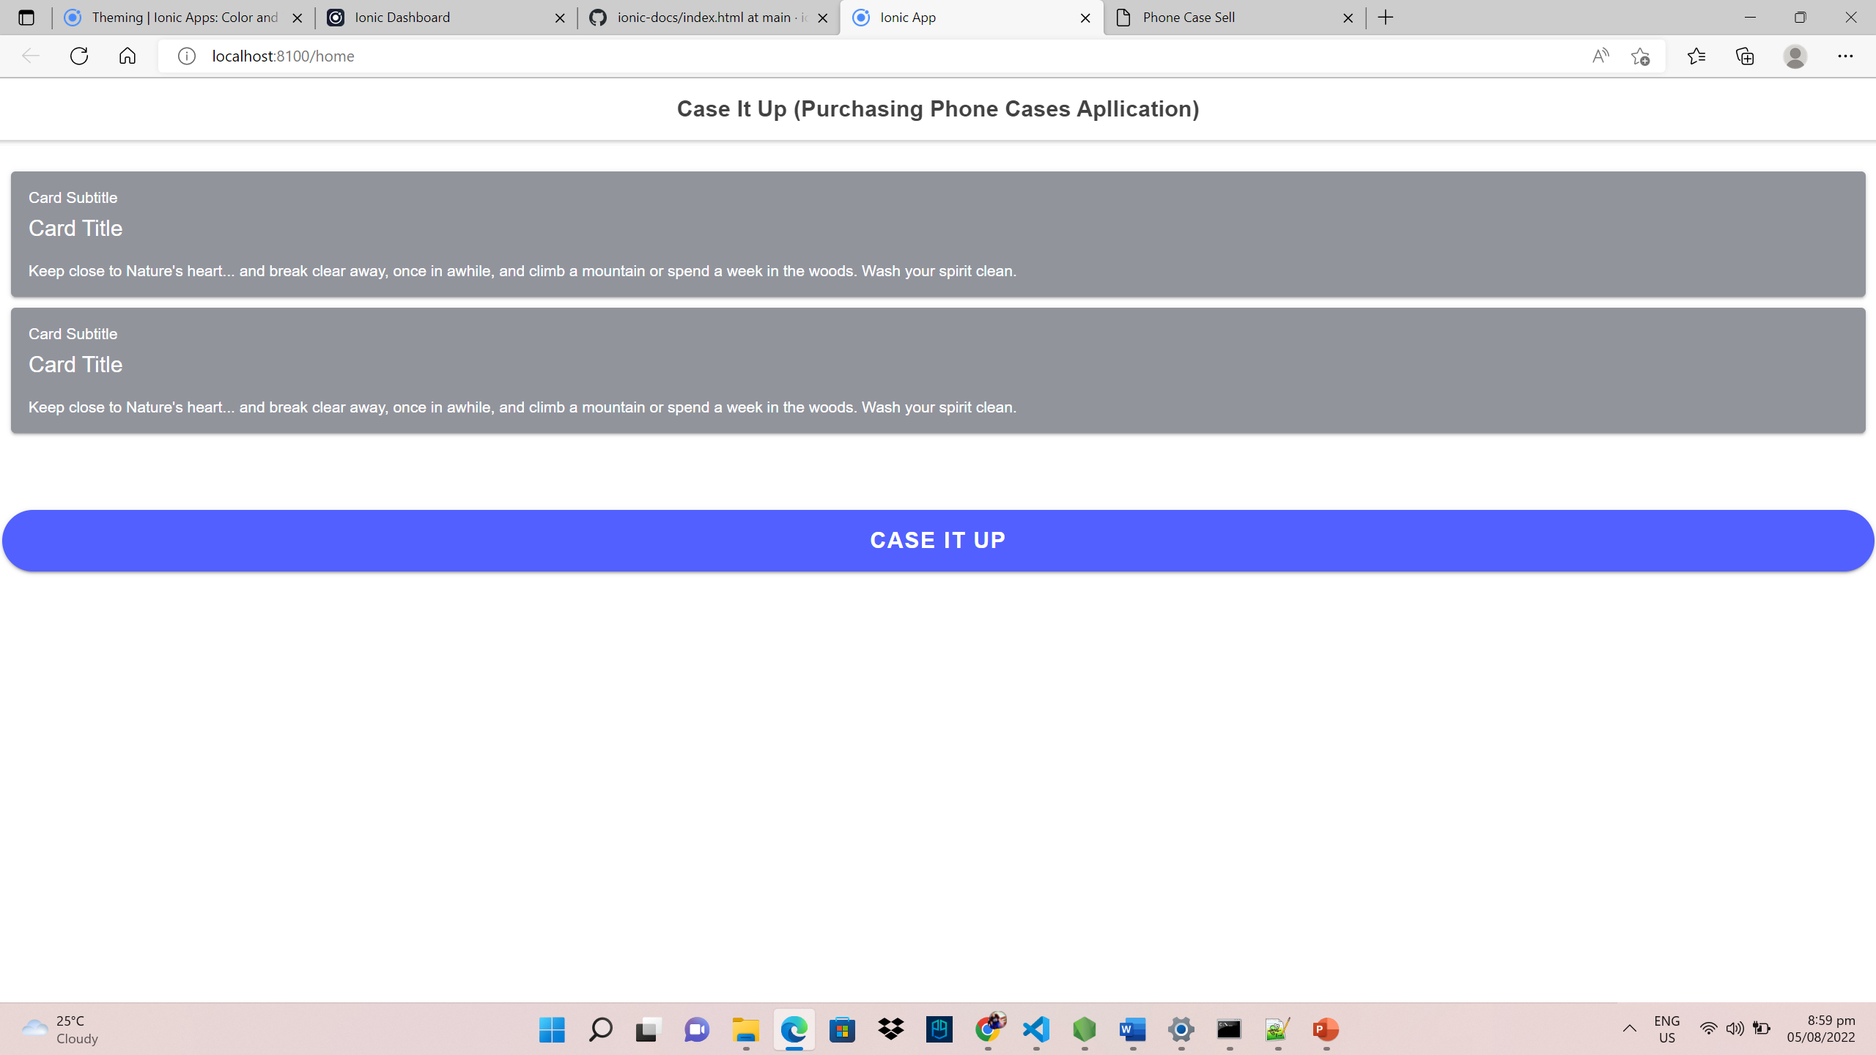
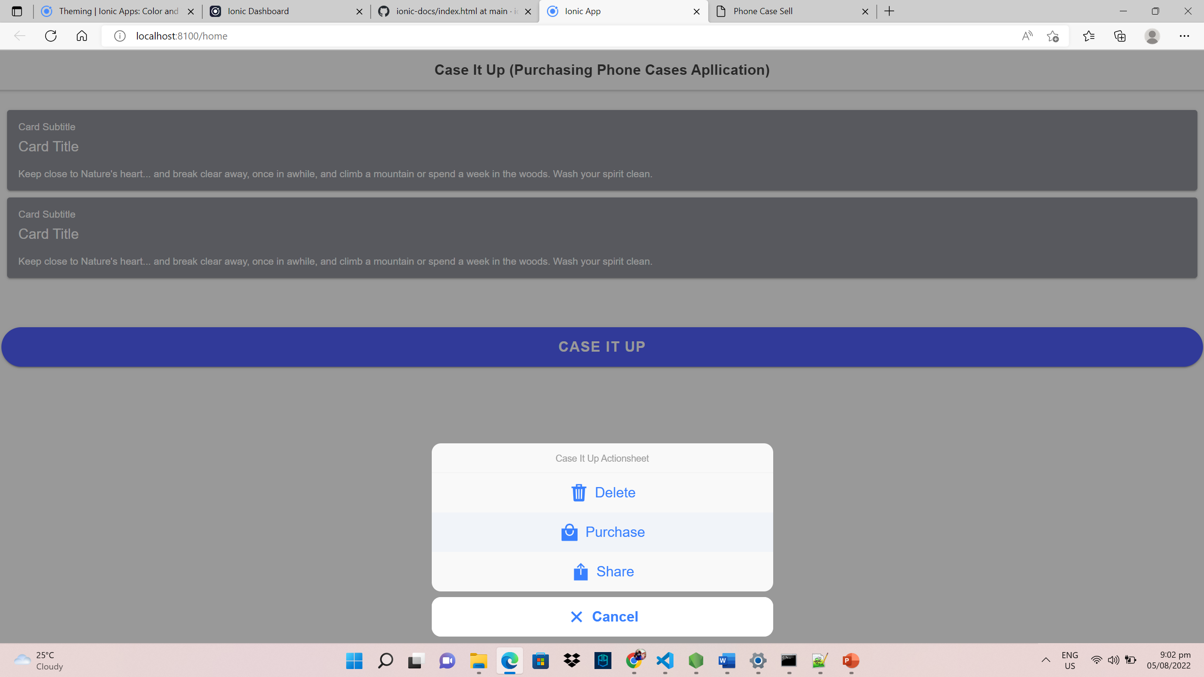
APPLICATION SCREENSHOTS

Slide 9
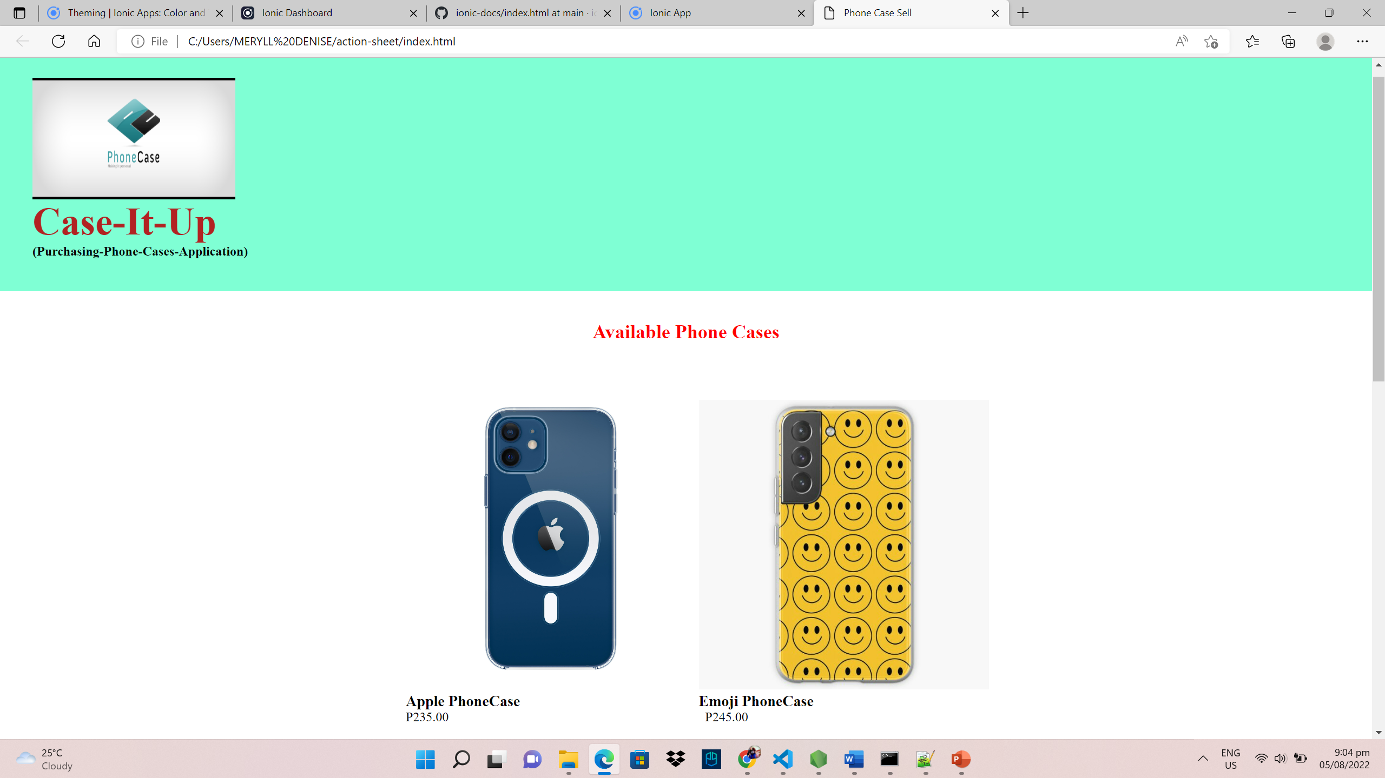
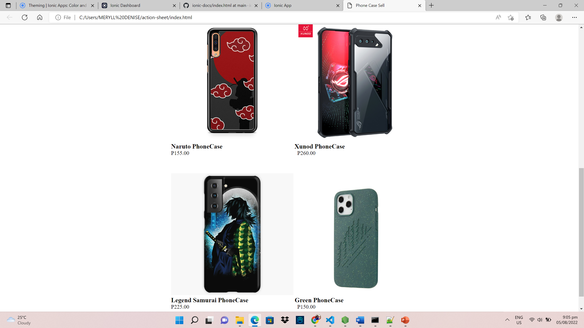
APPLICATION SCREENSHOTS

Slide 10
Cacao, Bience Nico H.
TEAM MEMBERS
Project Manager
Responsible for the complete project scope, the budget for the project, and the accomplishment or failure of the project
Project Analyst
Supports the project manager in overseeing the project and many more.
Reyes, Allen Francis Z.
Programmer
Creates the source code for the proposed application.
Garcia, Carlo

Slide 11

TEAM MEMBERS
Designer
Responsible for the design of the mobile application and ensures the user-friendliness of the application in general.
Villanueva, Meryll Denise C.
Documentation
Responsible for the creation of the document that goes along with the proposed application and that it answers the possible question about the software.
Alapide, Rhea Mae D.

